Slide 1






10 lessons after 1000 hours with Blazor
13/05/2022
@rogiervdhee

Slide 2
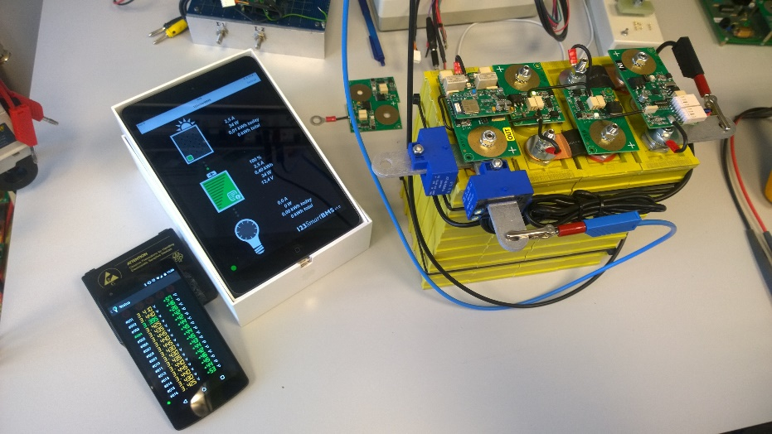



Rogier van der Hee
Simulation & gaming
90’s: Web (IE4 & Netscape Navigator)
2002-2007: Java Swing, C/C++ (Solaris / Linux)
2007 - : .NET! C#, Silverlight, ASP.NET, WinForms, WPF, Xamarin, AngularJS, Typescript
2020 - : Blazor! Blazor! Blazor!
@rogiervdhee

Slide 3

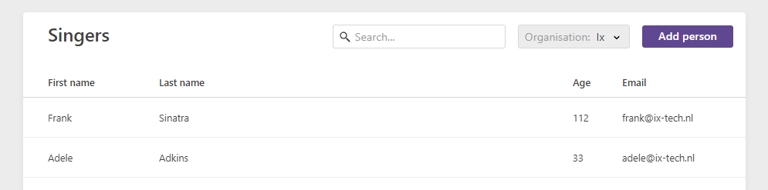

What did you do in 1000 hours?
Built our own component suite:
grid, editors, modals, buttons, etc
Games for Air Traffic Control and Training & Education

Slide 4
Blazor hosting models
WebAssembly
Server
Host
(index.html / ASP)
ASP.NET Core
Server
dotnet.wasm et al
API calls
etc
SignalR diff
User
interaction
Client
Browser
Browser

Slide 5

WebAssembly vs Server
WebAssembly
Runs in browser
Static hosting option
~700kb runtime
Typical app 3-5mb
Interpreted “slow”
AOT ~2x size, 10x speed
Server
Fast startup
Scaling hard
Sticky sessions
Chatty connection
No BFF API needed
Fast dev loop
Maybe not public facing website, but internal facing websites yes!

Slide 6

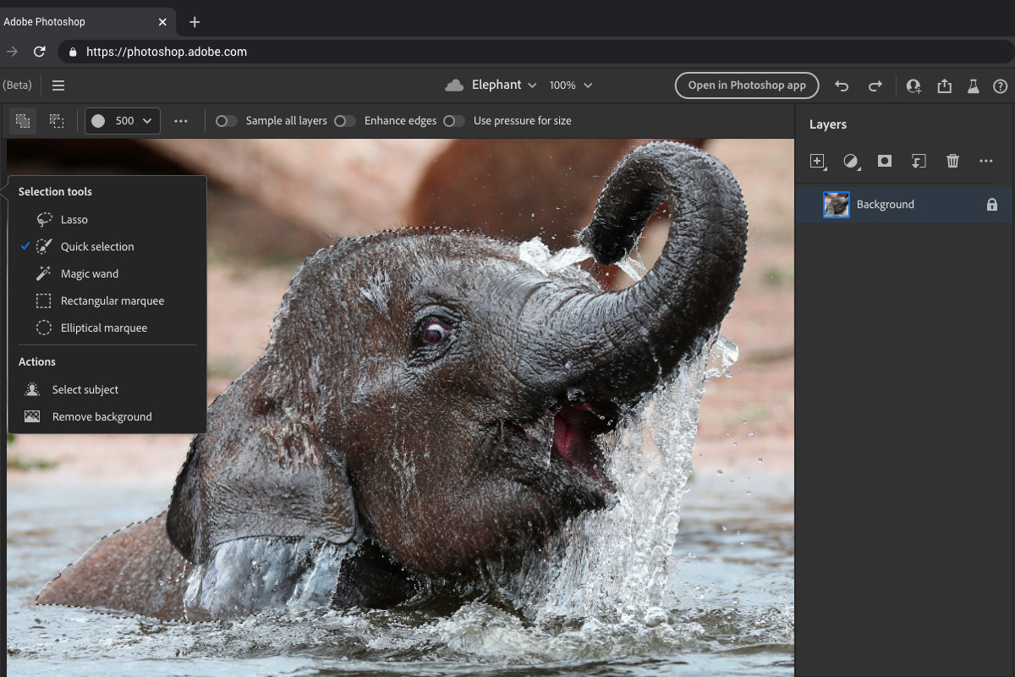


WebAssembly
Will Microsoft Silverlight Blazor?
Notes:
https://www.theverge.com/2021/10/26/22738125/adobe-photoshop-illustrator-web-announced

Slide 7


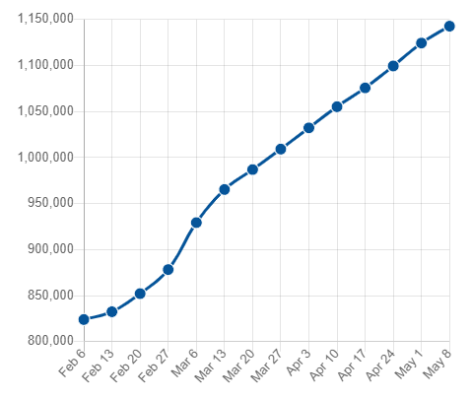
WebAssembly
https://bunit.dev/

Slide 8
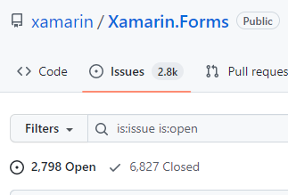

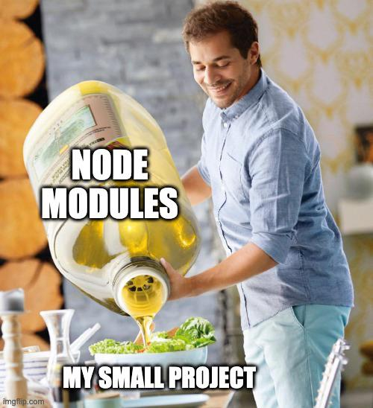

One Tool One Language One Framework
1
One Language (mostly)
One Tool
One Framework
One Debugger
One Ecosystem (mostly)

Slide 9

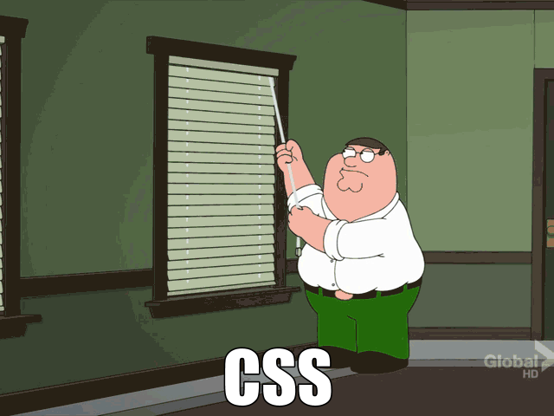
CSS is fine
2
I’m so old I did rounded borders with separate images in a button (or HTML in e-mails in 2021)

Slide 10


CSS is fine (2)
2
Tables
Float
Grid
Hack days are over
CSS Grid best thing since sliced bread
Scoped CSS well … scopes CSS so less messy
Hot Reload for fast dev loop
Just learn it properly!

Slide 11
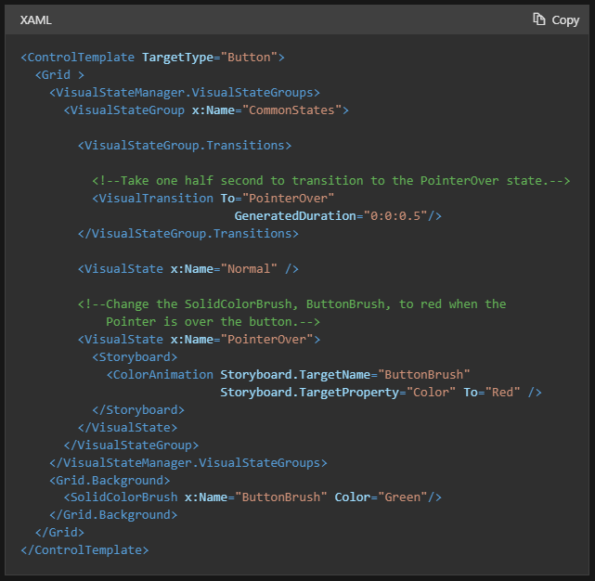
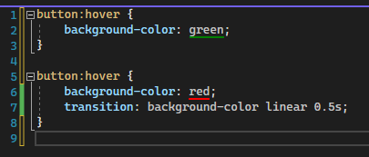

XAML vs CSS
2

Slide 12

Anything you can do in JavaScript You can do in Blazor
3
JavaScript: Embrace and Extend, not Extinguish
Gap to/from is like jumping over a pond (fierljeppen): think carefully before crossing in tight loops
WebAssembly cannot access DOM directly, overhead
Be aware that everything going to / from JavaScript is serialized, so you don’t have actual object references (e.g. with event handling)

Slide 13
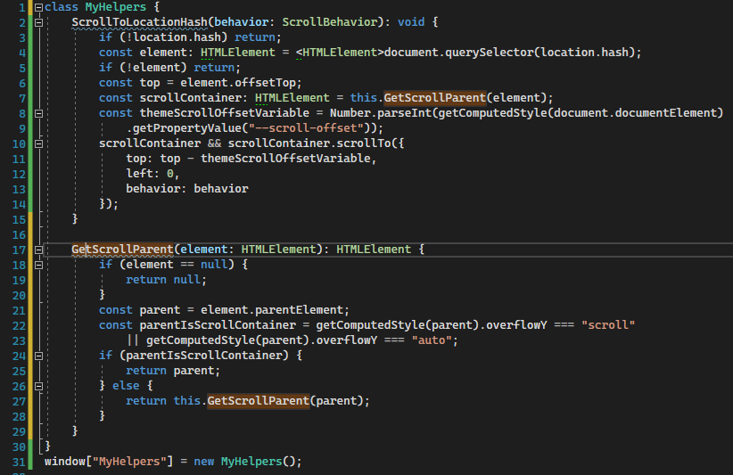
Anything you can do in JavaScript You can do in Blazor
3
Smooth scroll to location hash, e.g. "https://myurl/home#section1"
JavaScript:

Slide 14
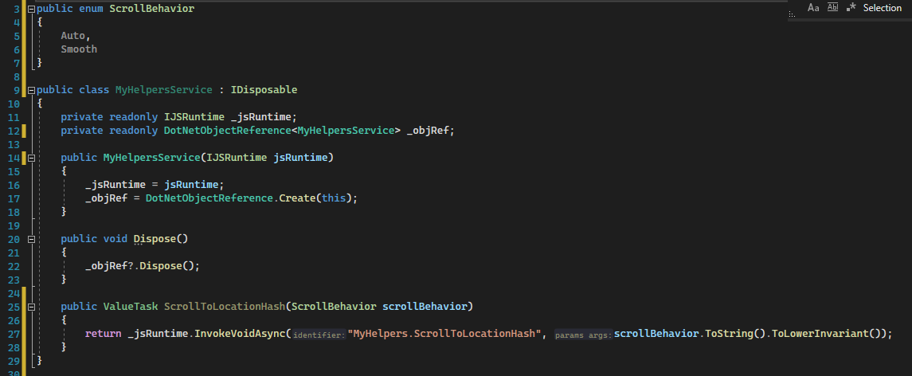
Anything you can do in JavaScript You can do in Blazor
3
C# side: Service

Slide 15


Anything you can do in JavaScript You can do in Blazor
3
Good sample for interop: BlazorSize
https://github.com/EdCharbeneau/BlazorSize
Generate JavaScript interop based on API:
https://github.com/IEvangelist/blazorators

Slide 16
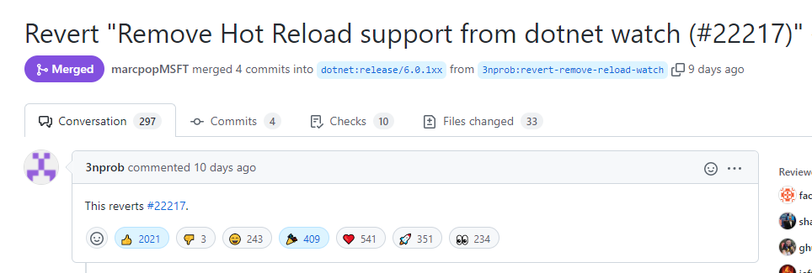

Tooling
4
Razor LSP editor so so (hard task!) but slowly improving => VS2022 17.2!!
Debugger still has ways to go
VS Code still ok-ish but not perfect, see the
dotnet watch
OmniSharp underfunded

Slide 17
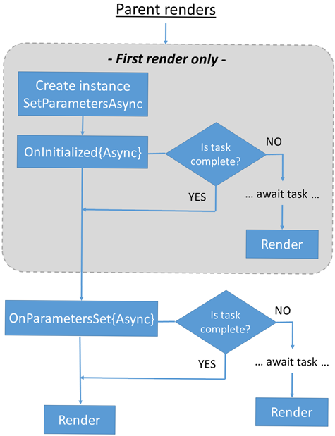
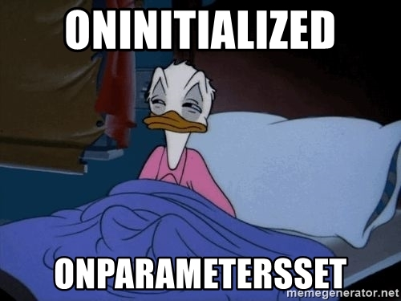
Know thy component lifecycle
5
Know it by heart, wake up at night and know

Slide 18
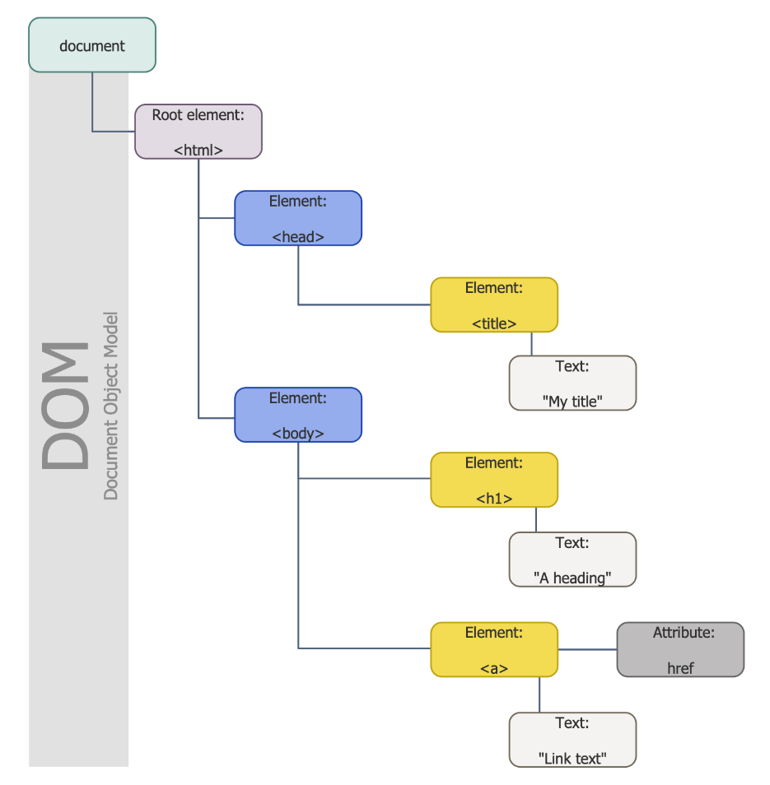
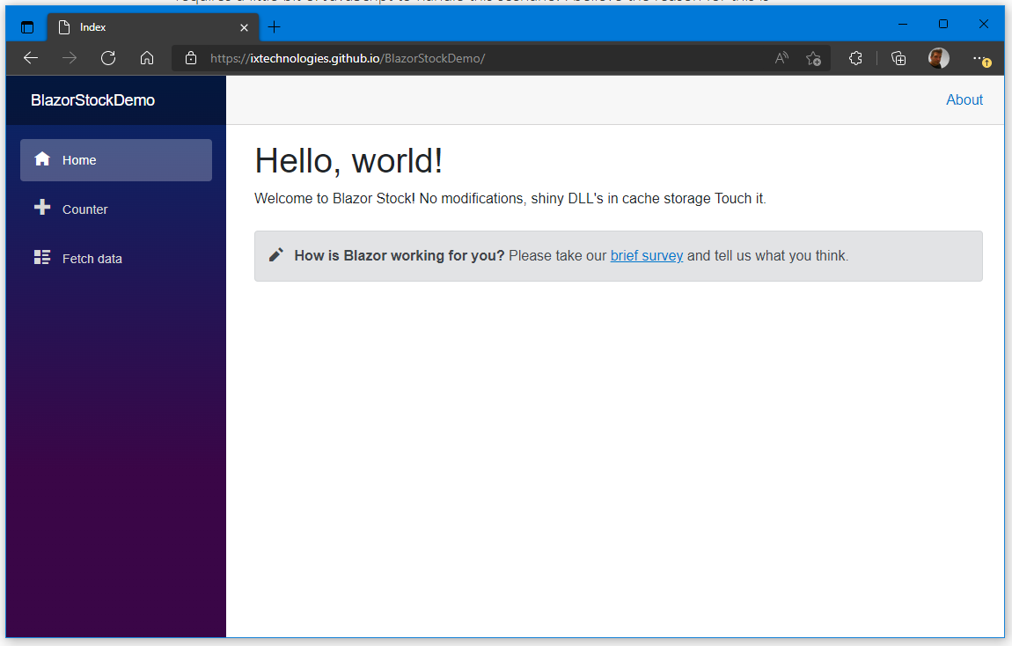
Know thy component lifecycle (2)
5
Render from top left to bottom right image
Various ways to optimize this but that is topic for another talk!

Slide 19

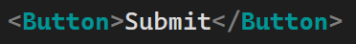
Composition over Inheritance, always
6
Make em small and open for composition
with fragments

Slide 20
State Management
7
Model: the data
Service: stores model, generates events
Event: when does the model change
Various other options: pass Model as parameter or properties of the Model. It depends bla bla bla.
Advice: start simple, expand if needed
Service
Change
Events
Update Model
Model
Render
View

Slide 21
State Management: MVVM
7
Bindings / Commands
Data updates
View
View Model
Model
State changes
Data changes

Slide 22
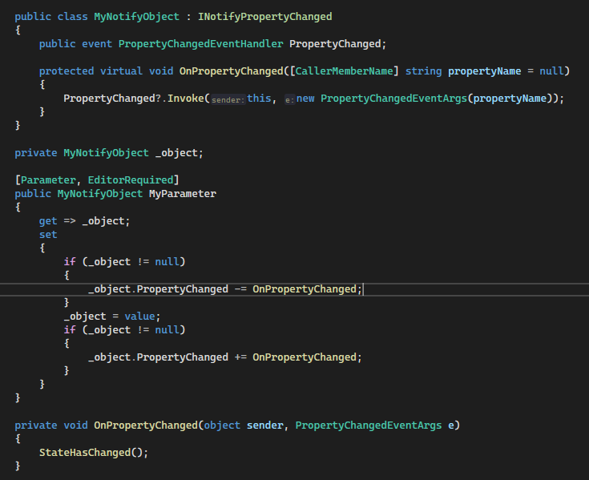
State Management: MVVM (2)
7

Slide 23

State Management: Fluxor
7
Action
Action
Dispatcher
Store
View
https://dev.to/mr_eking/advanced-blazor-state-management-using-fluxor-part-1-696 => watch the Carl Franklin video
https://github.com/mrpmorris/Fluxor

Slide 24

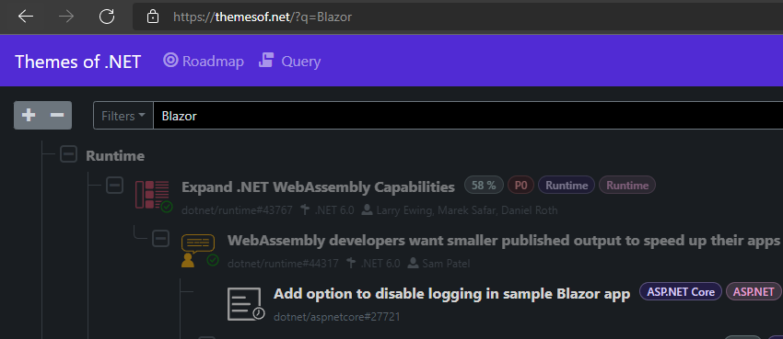


Interact, vote matters!
8
Microsoft listens! https://themesof.net/
Nov – Dec planning!
Jan – Jun development
Jul-Aug cutting ☺
Sep-Oct release candidates, documentation
Nov release

Slide 25

Wait, but… but what about Native / Desktop?
9
“Did anyone say … native? I need one more native”

Slide 26





State of Desktop on Windows 2022
9
WinForms
WPF
Silverlight
2000
2005
2010
2015
2020
2025
2002 - : WinForms
2006 - : WPF
2007 - 2021: Silverlight
WinForms got some small updates
WPF is / was on life support with no assigned team members

Slide 27



State of Desktop on Windows 2022
9
WindowsPhone
Silver light
WinUI 3
WinForms
WPF
UWP
2000
2005
2010
2015
2020
2025
2010 – 2015 : Windows Phone (Mobile 2020)
2015 – ???? : UWP
2021 – ???? : WinUI 3

Slide 28



Alternatives and cross platform
9
Platform Uno
Flutter (DART, Google)
.NET MAUI
Notes:
.NET MAUI not yet ready

Slide 29

Alternatives and cross platform
9
Personal opinion
XAML feels antiquated by Razor / modern CSS
Web eats Native
Maybe not because its better but because developing native apps is a mess
Hybrid FTW?
Notes:
.NET MAUI not yet ready

Slide 30

The Future
10
Will we have .NET based native exe that is platform agnostic, small, automatic updates outside store (10-20mb)?
WASM Multi-Threading (.NET 7)
WASM AOT improvements (.NET 7)
Native renderer for Razor for MAUI, replace XAML?
Mobile Blazor Bindings part deux
Blazor Hybrid a.k.a. Electron killer

Slide 31


The Future (2)
10
WebAssembly outside the browser – WebAssembly System Interface (WASI)
WebAssembly improvements, piece by piece replace parts of runtime by native capabilities (Threading, Garbage Collection, JIT)
DOM access for WebAssembly

Slide 32
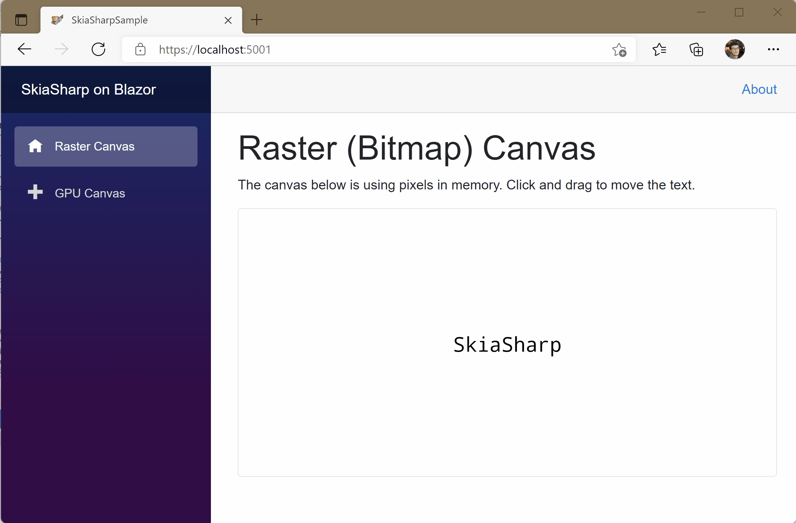
The Future
10
It’s already here:
SkiaSharp in Blazor WebAssembly!

Slide 33




Some more resources
.NET PodCast sample: https://github.com/microsoft/dotnet-podcasts
https://www.reddit.com/r/Blazor/
https://github.com/AdrienTorris/awesome-blazor
https://blazor-university.com/
Chris Sainty
Notes:
- PODCast app has it all: MAUI app, WebAssembly app, Minimal API’s, SignalR

Slide 34
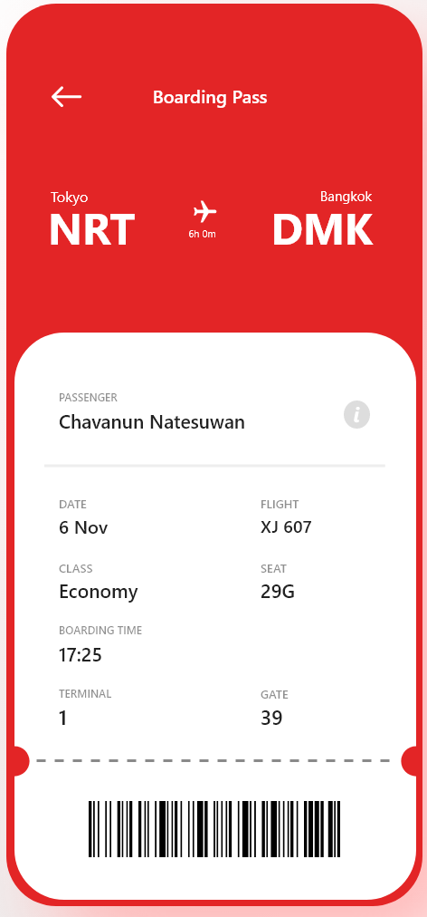
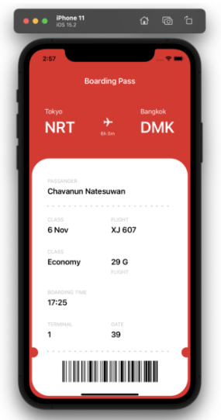

Boarding Pass sample
https://askxammy.com/replicating-boarding-pass-ui-in-xamarin-forms/

Slide 35
Break it down
SourceDestination
Header
“Flight”
FlightDuration
Icon
LabelText
BoardingPassView
Barcode
Body
“Passenger”

Slide 36



Architecture Boarding Pass app
5
Frontend
Backend
API ASP Core
PlatformApp
App Blazor WebAssembly
Components
Shared
Api
Razor Class Lib .NET6 Browser
User
Class lib .NET6 Browser
WasmApp
MAUI App .NET6-android/..
Notes:
Transitive dependencies!
App / Web are containers and compose other building blocks

Slide 37
Intermezzo
Demo and Code walkthrough
Code: https://github.com/rogihee/boardingpassui

Slide 38

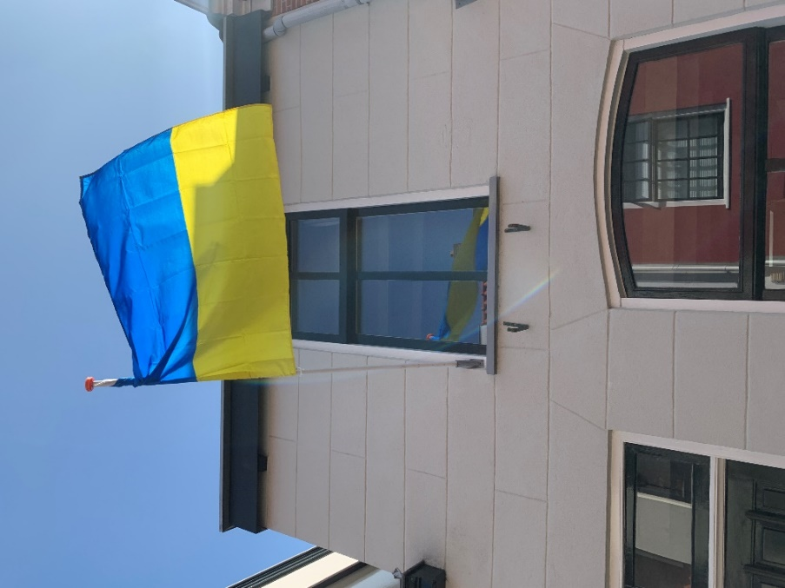

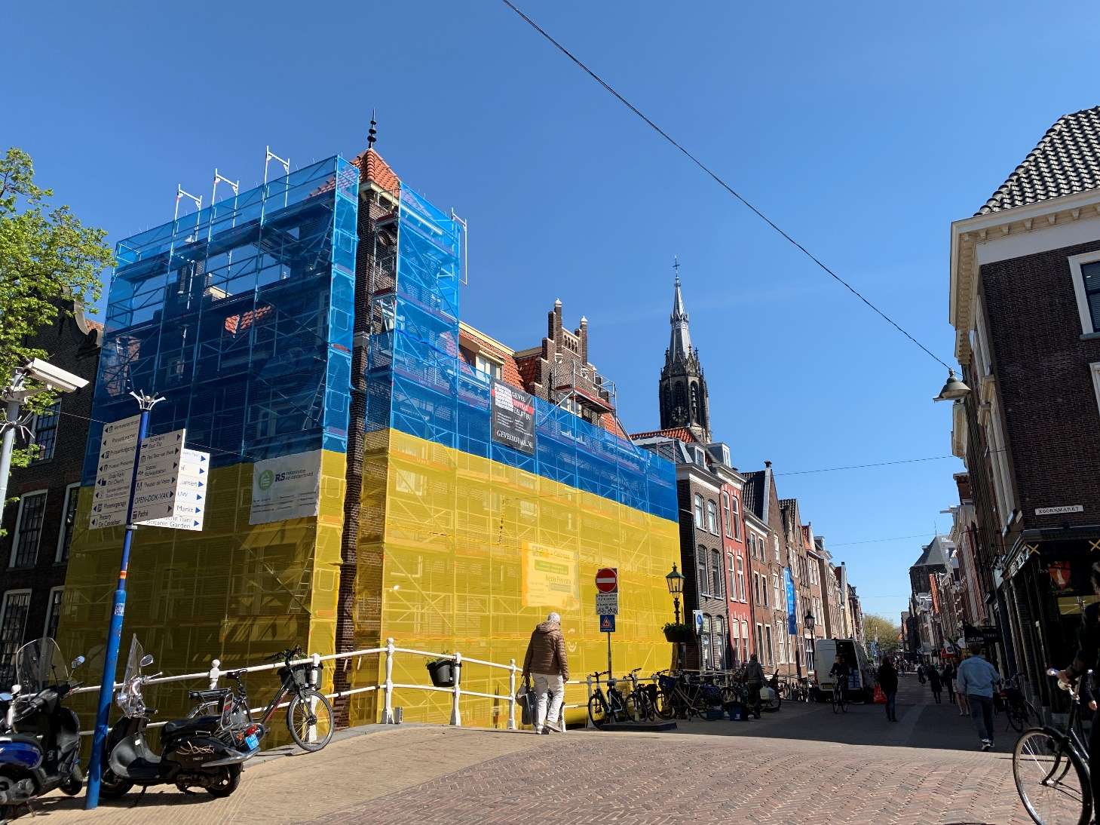
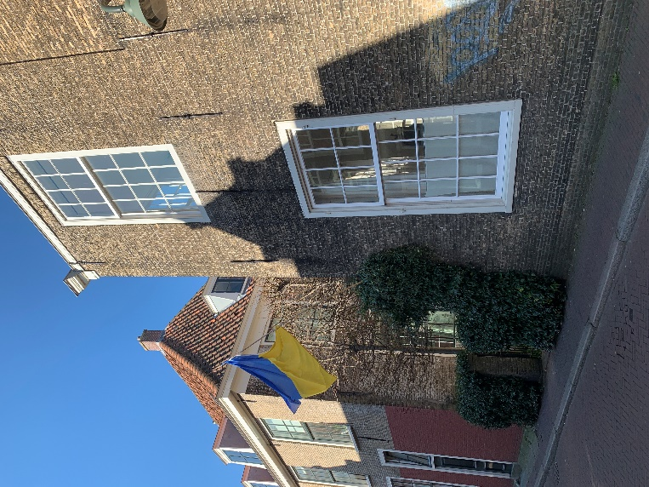
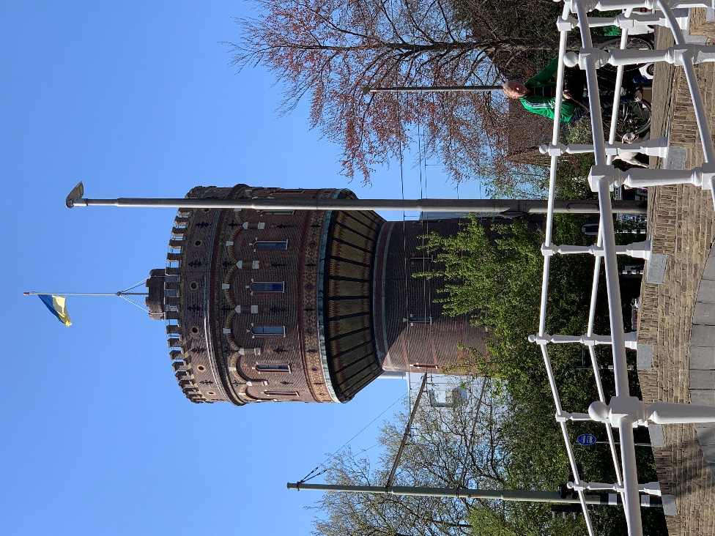

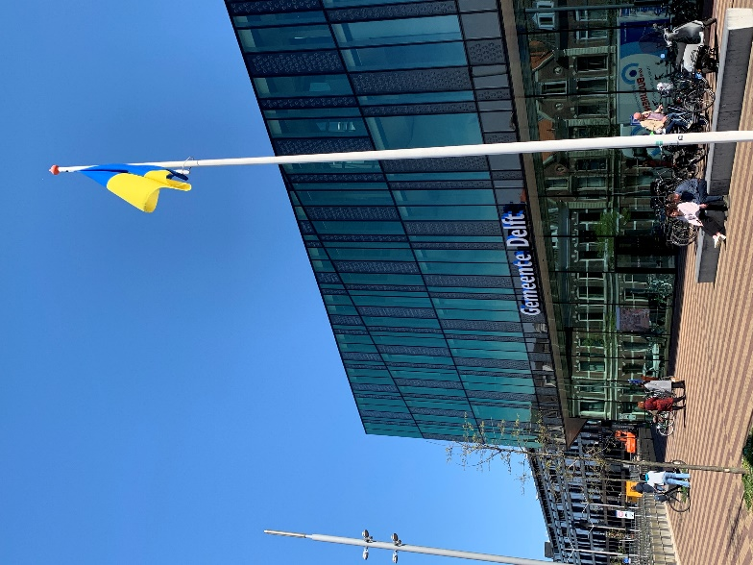
Notes:
Delft, The Netherlands

